Slide 1
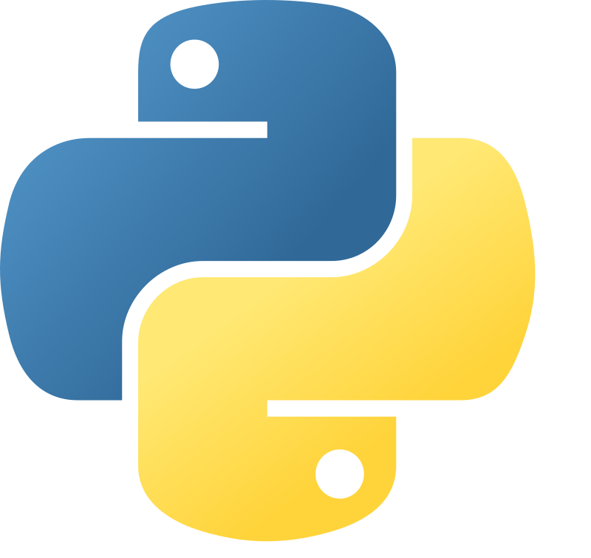

Python Primer
Intro to Procedural Python

Slide 2

Basic setup
Visual Studio Code: https://code.visualstudio.com/download
GIT: https://git-scm.com/downloads
Python: https://www.python.org/downloads/release/python-3132/
Github: https://github.com/BjarneHelgesen/PythonPrimer/
git clone https://github.com/BjarneHelgesen/PythonPrimer/
to a source folder
In VS Code:
ctrl-shift-P, «Python: select interpreter» and «Debug: Select and Start Debugging»
Run helloworld.py from cloned repo

Slide 3


Progress speed
Homework

Slide 4
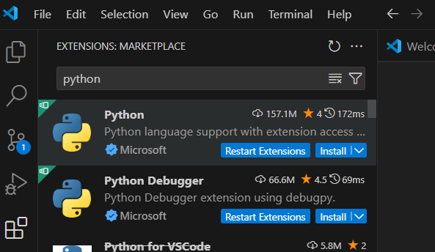
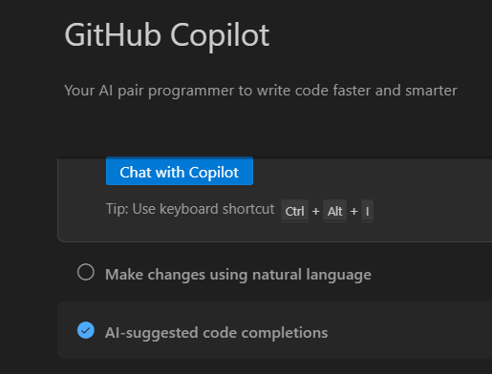
Install plugins

Slide 5

Python paradigms
Procedural
Object oriented
Functional
We will use objects, but we will not create new types of objects.
We will use and create functions.

Slide 6

Unit tests - code that tests code
Reading unit tests show how the code is supposed to work. It is documentation in code.
Helps design code with low coupling, e.g. combined with test-driven development, TDD
Catches regressions

